Slide 1
Agri Product Price Prediction
SALMAN A
PES1PG23CA350
SECTION ‘F’
01

Slide 2


ABSTRACT
Problem Statement and Objective
Understanding the importance of accurate price predictions for commodities in
various markets
The impact of price fluctuations on farmers, traders, and consumers.
To predict the daily modal prices of specific commodities using historical data.
02

Slide 3

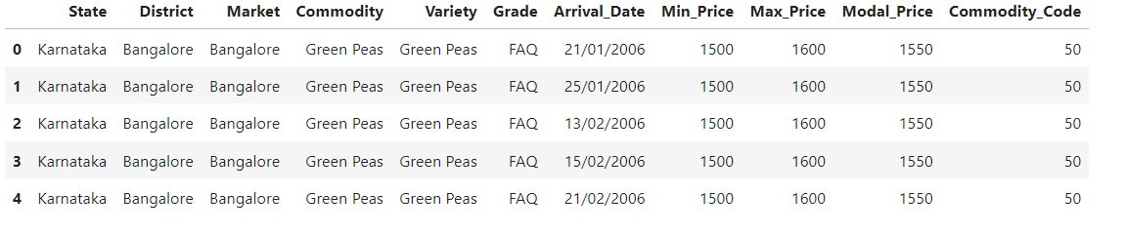
SOURCE OF THE DATA
01
Source of the Data:
Data collected from: data.gov.in
https://www.data.gov.in/catalog/current-daily-price-various-commodities-various-markets-mandi
DATASET STRUCTURE
02
03

Slide 4

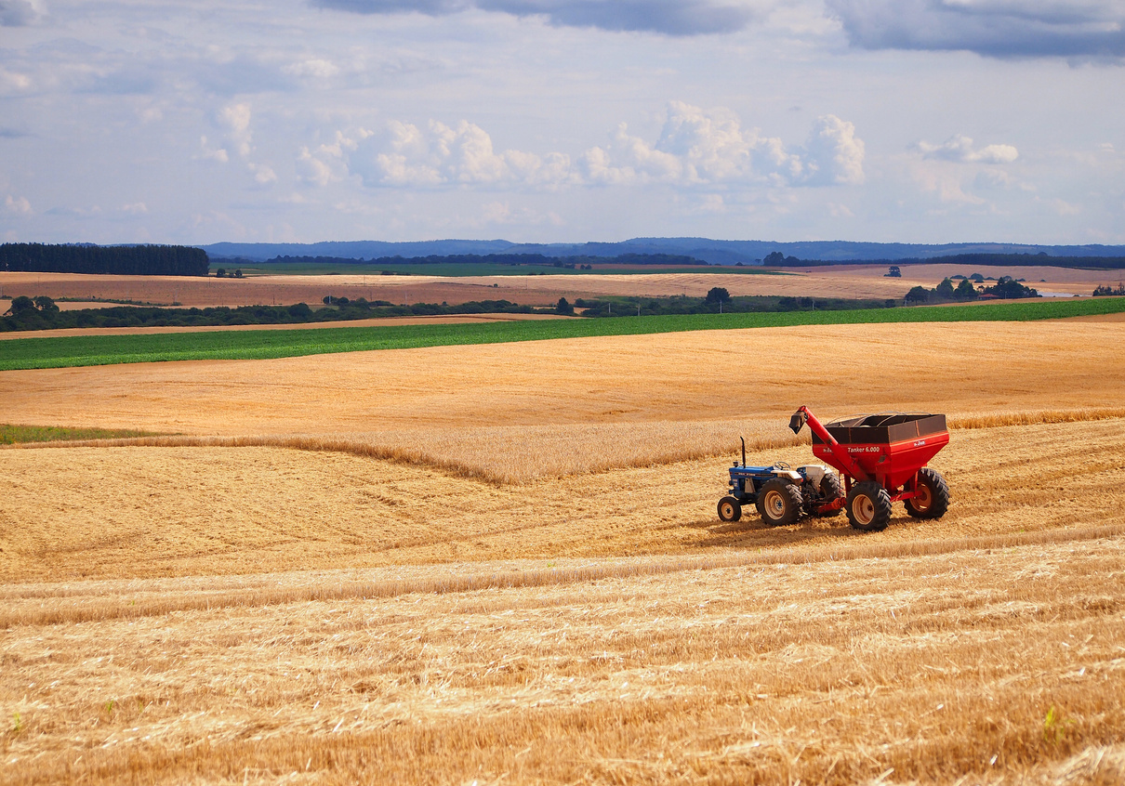


ATTRIBUTES
01
STATE: Represents the state in which the market is located.
Used for regional analysis and feature engineering
02
DISTRICT: Specifies the district within the state.
Helps in understanding local market trends
03
MARKET: The specific market where the commodity data is collected.
04
COMMODITY: The type of commodity being analyzed .
04

Slide 5

ATTRIBUTES
01
VARIETY: Specifies the variety of the commodity (e.g., Durum wheat, Basmati rice).
02
MAX_PRICE: The maximum price recorded for the commodity on that day.
03
ARRIVAL_DATE: The date when the data was recorded or the commodity arrived in the market.
04
MODAL_PRICE: he most common price at which the commodity was traded.
05
MIN_PRICE: The minimum price recorded for the commodity on that day.
06
CODE: A unique identifier for each record
05

Slide 6


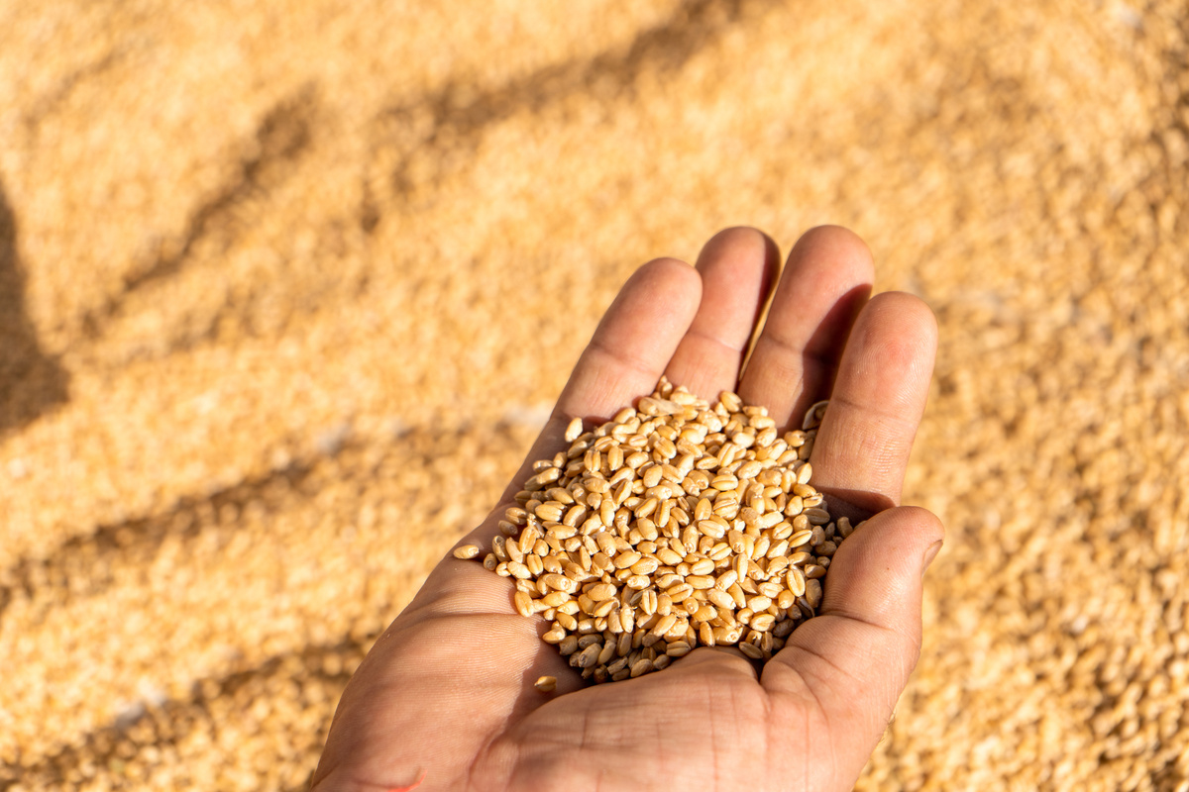
ALGORITHM’S USED
Chosen Algorithm:
Linear Regression: A simple and interpretable model for price prediction.
Random Forest: An ensemble method that can handle non-linear relationships and interactions between variables.
LSTM (Long Short-Term Memory): A neural network model suitable for time-series data, capturing temporal dependencies.
Reason for Selection:
Linear Regression: Good for initial baseline and interpretability.
Random Forest: Handles complex interactions and provides feature importance.
LSTM: Suitable for capturing long-term dependencies in time-series data.
06

Slide 7

Thank You
07

